Slide 1
Module 8

Slide 2
Nutrition in plants
Like animals, plants also need food for growth and energy.
Green plants synthesize their food by the process of photosynthesis.
Produce

Slide 3
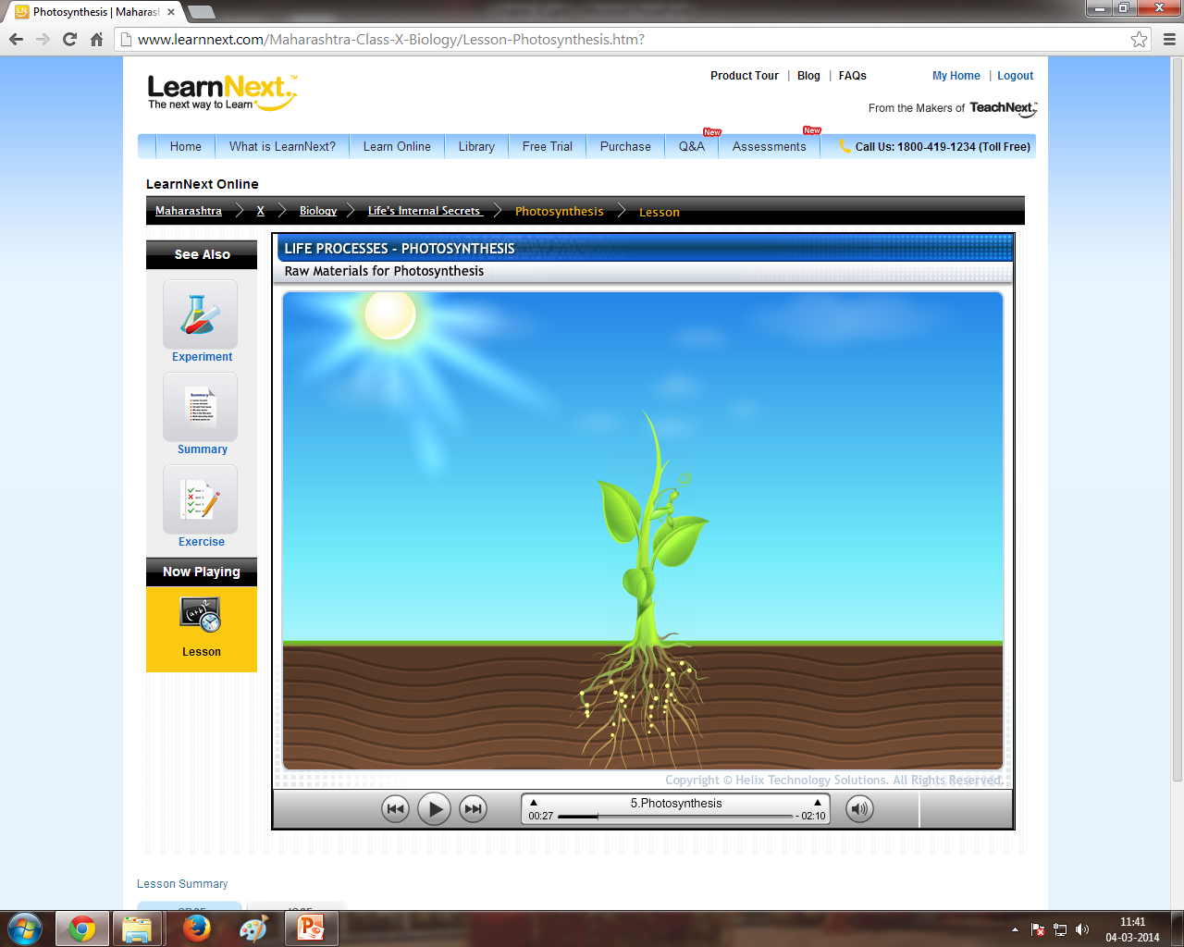
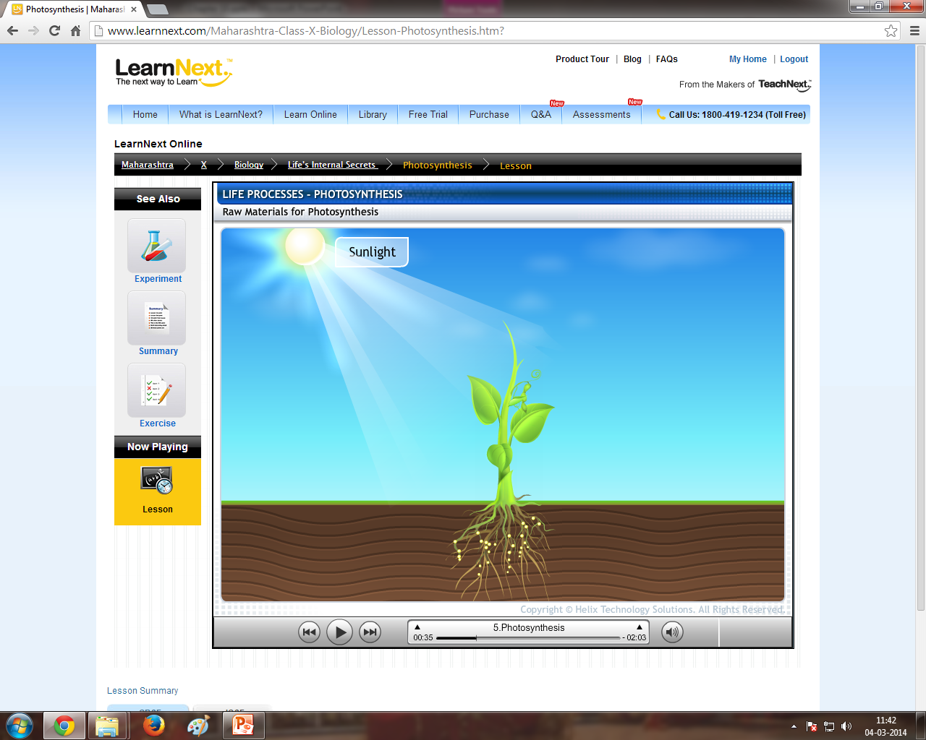

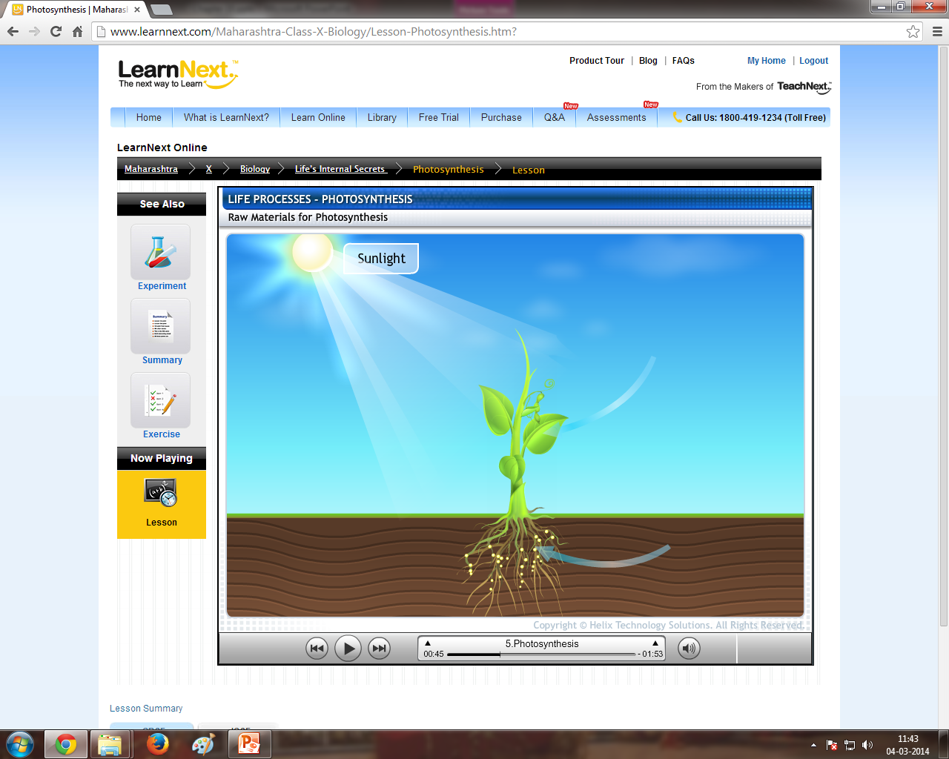
Green plants
In the presence of
CO₂
By a process known as
Take in
Photosynthesis
And
Chlorophyll
Excess glucose is stored in the form of
Carbohydrates
(Glucose)
Convert it into
Starch
And
H₂O

Slide 4


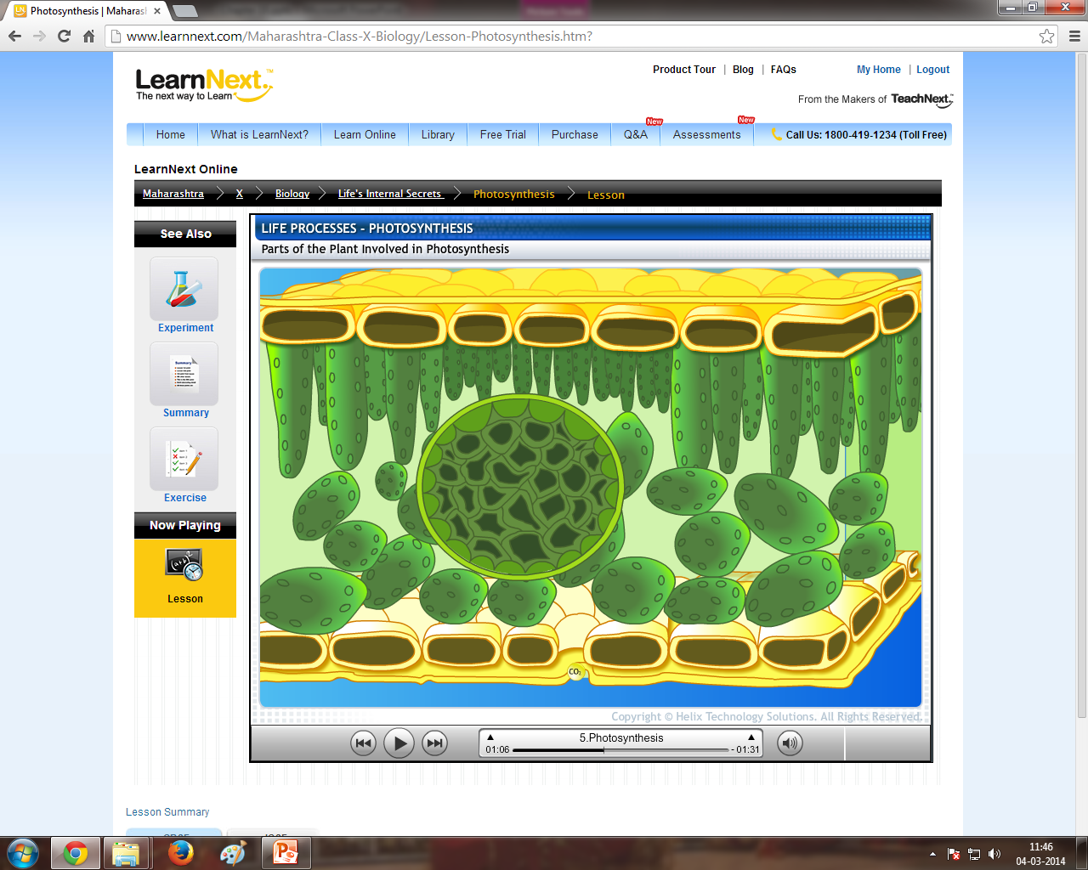
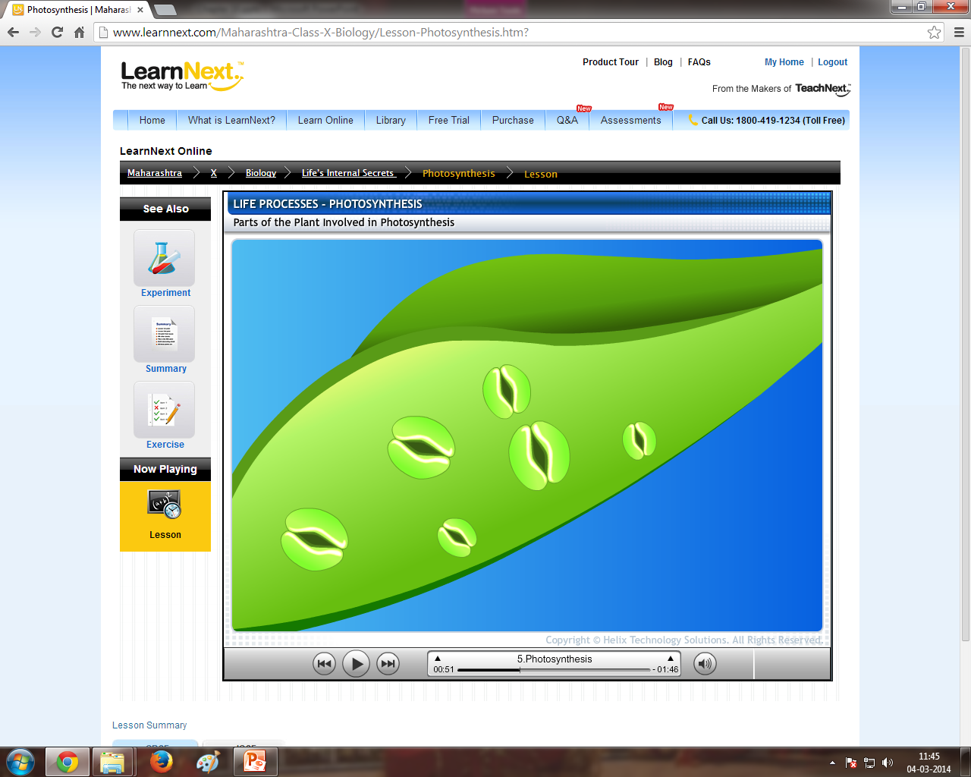
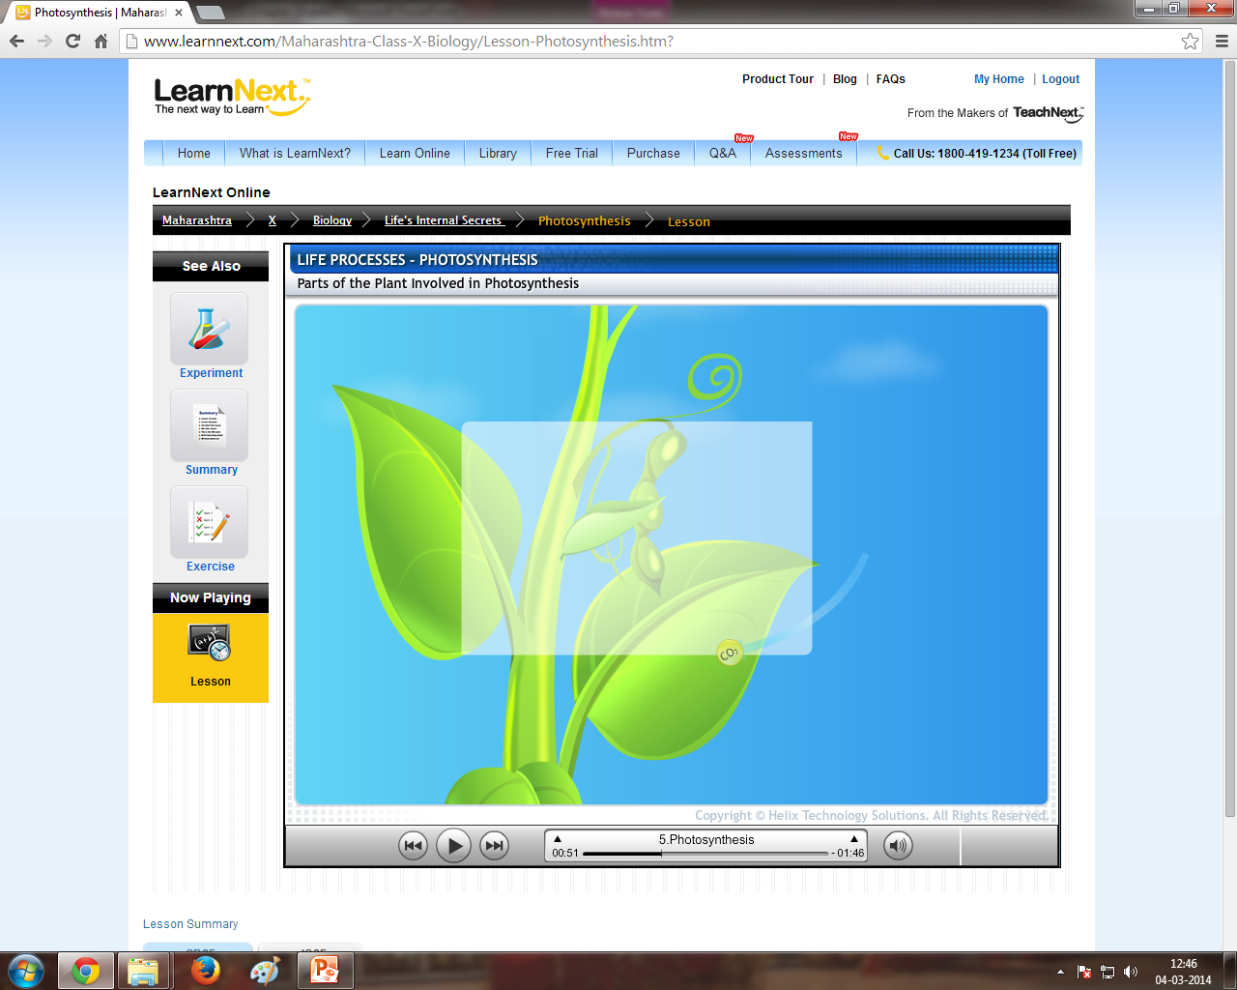
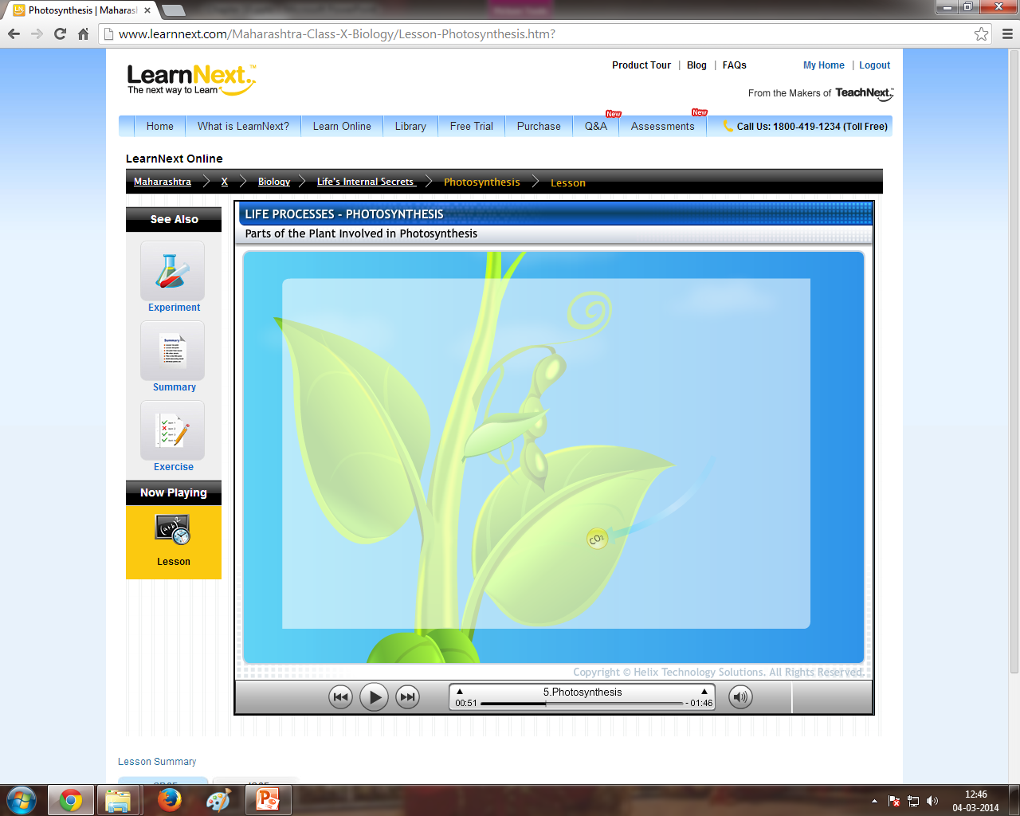
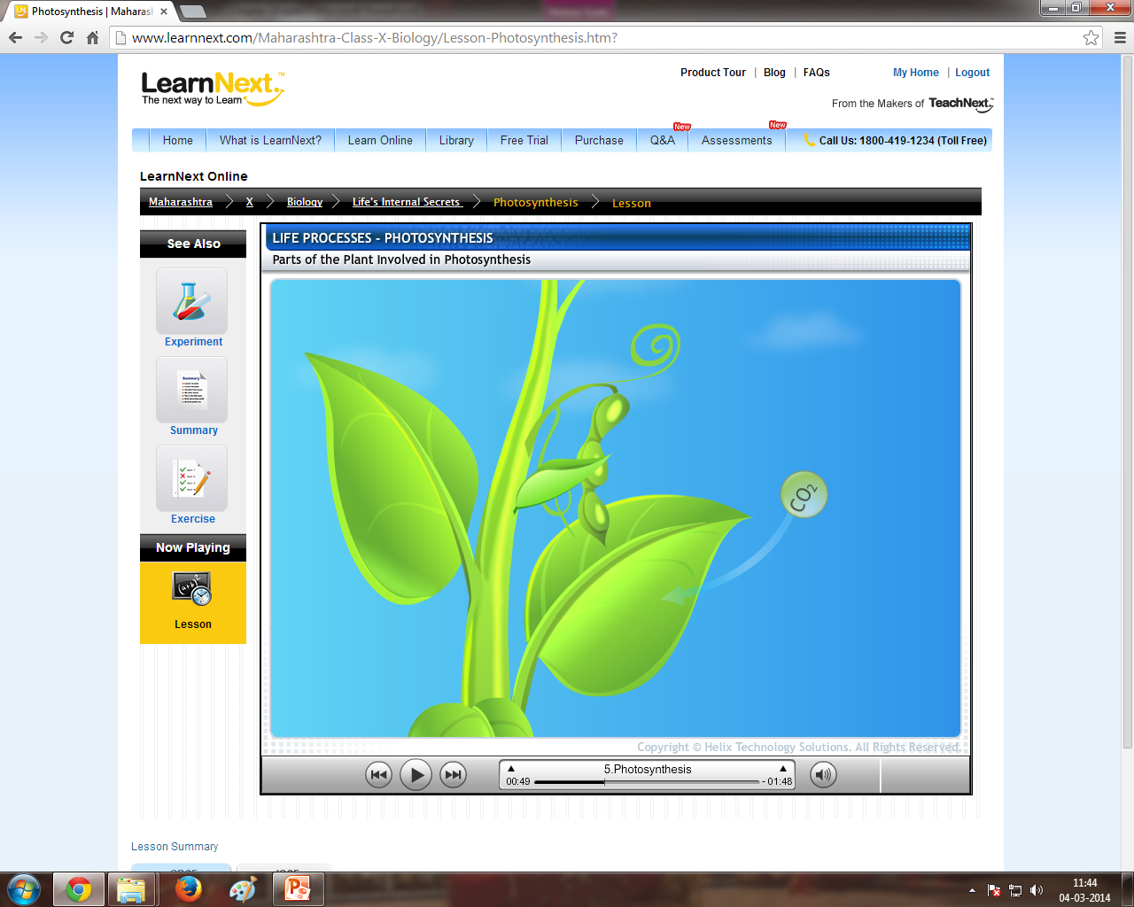
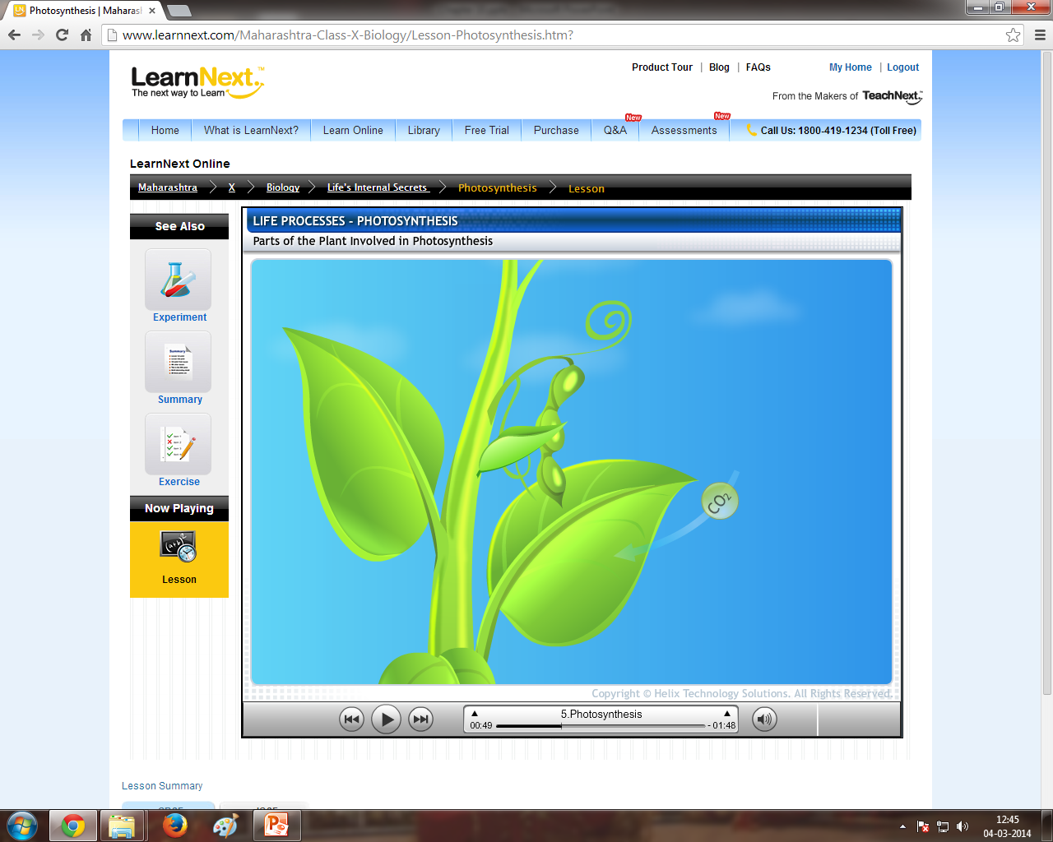


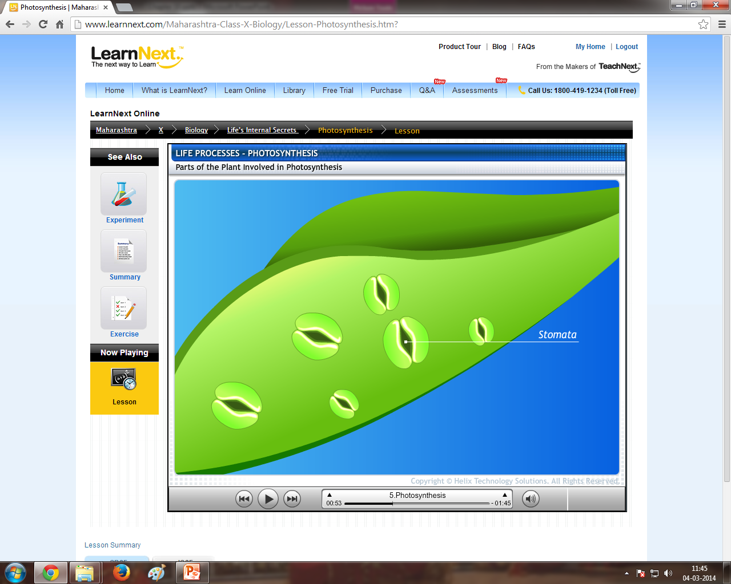
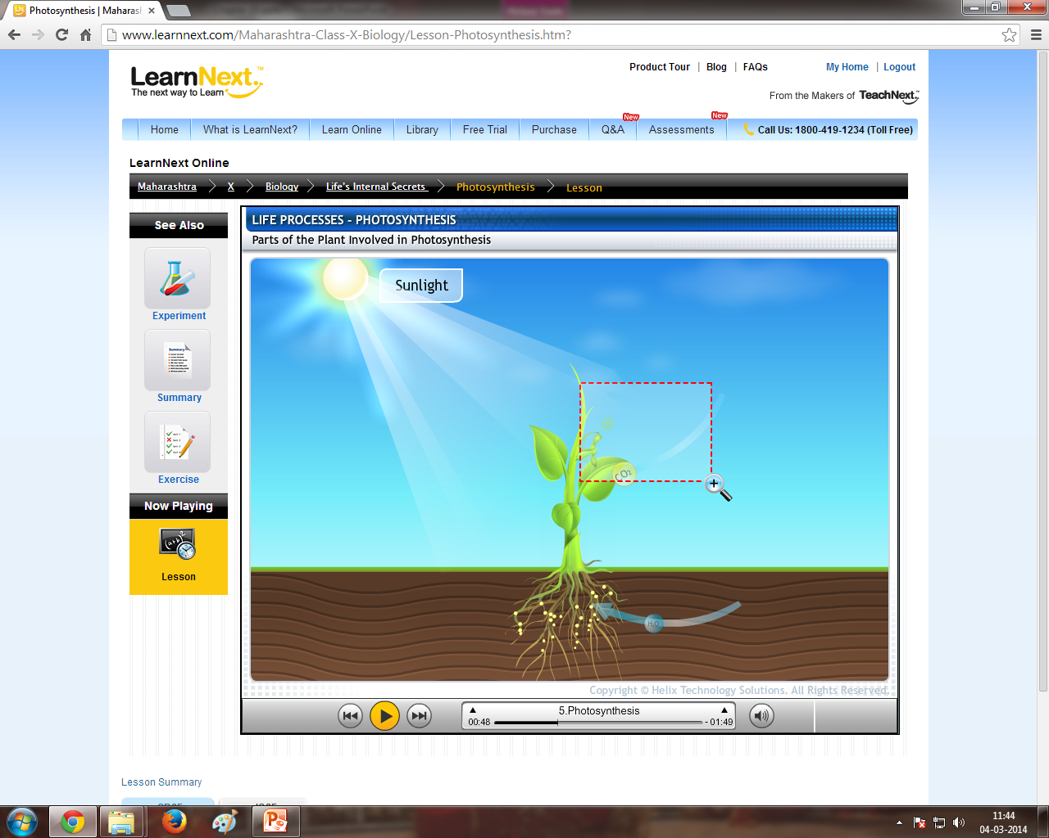


Process of photosynthesis
Sunlight
Carbon dioxide enters into the leaves through tiny pores present on the surface of the leaf called stomata.
Chlorophyll present in the chloroplasts absorbs the radiant energy from the sunlight.
When light energy enters inside, water molecules split into hydrogen and oxygen.
This releases energy in the form of ATP (Adenosine Tri Phospate).
Water vapour and oxygen are formed as by products.
They are given out through the stomata.
This energy is used to convert Carbon dioxide and Hydrogen into carbohydrates. i.e., glucose (C₆H₁₂O₆).
Reaction for photosynthesis :
Sunlight
Water is taken up from the soil.
6CO₂ + 12H₂O
C₆H₁₂O₆ + 6H₂O + 6O₂
Chlorophyll
(Glucose)
(Water)
(Oxygen)
Chlorophyll
H₂O
CO₂
CO₂
Chloroplasts
C₆H₁₂O₆
O₂
Glucose
O
H
H
H₂O
CO₂
H₂O
CO₂

Slide 5


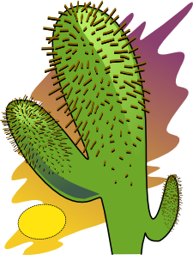
Then during day time the intermediate product is acted upon by energy absorbed by chlorophyll and converted into
Take in CO₂ at night
And convert it into
CO₂
The steps of photosynthesis do not take place one after another immediately
Intermediate product
CO₂
(Glucose)
Product before the final product
Desert plants

Slide 6
Thank You

